Slide 1
Slide 1
Presented By Uri Ladabaum at 2020 Gastrointestinal Cancer Symposium

Slide 2
Slide 2
Presented By Uri Ladabaum at 2020 Gastrointestinal Cancer Symposium

Slide 3
Slide 4
Presented By Uri Ladabaum at 2020 Gastrointestinal Cancer Symposium

Slide 4
Slide 5
Presented By Uri Ladabaum at 2020 Gastrointestinal Cancer Symposium

Slide 5
Slide 6
Presented By Uri Ladabaum at 2020 Gastrointestinal Cancer Symposium

Slide 6
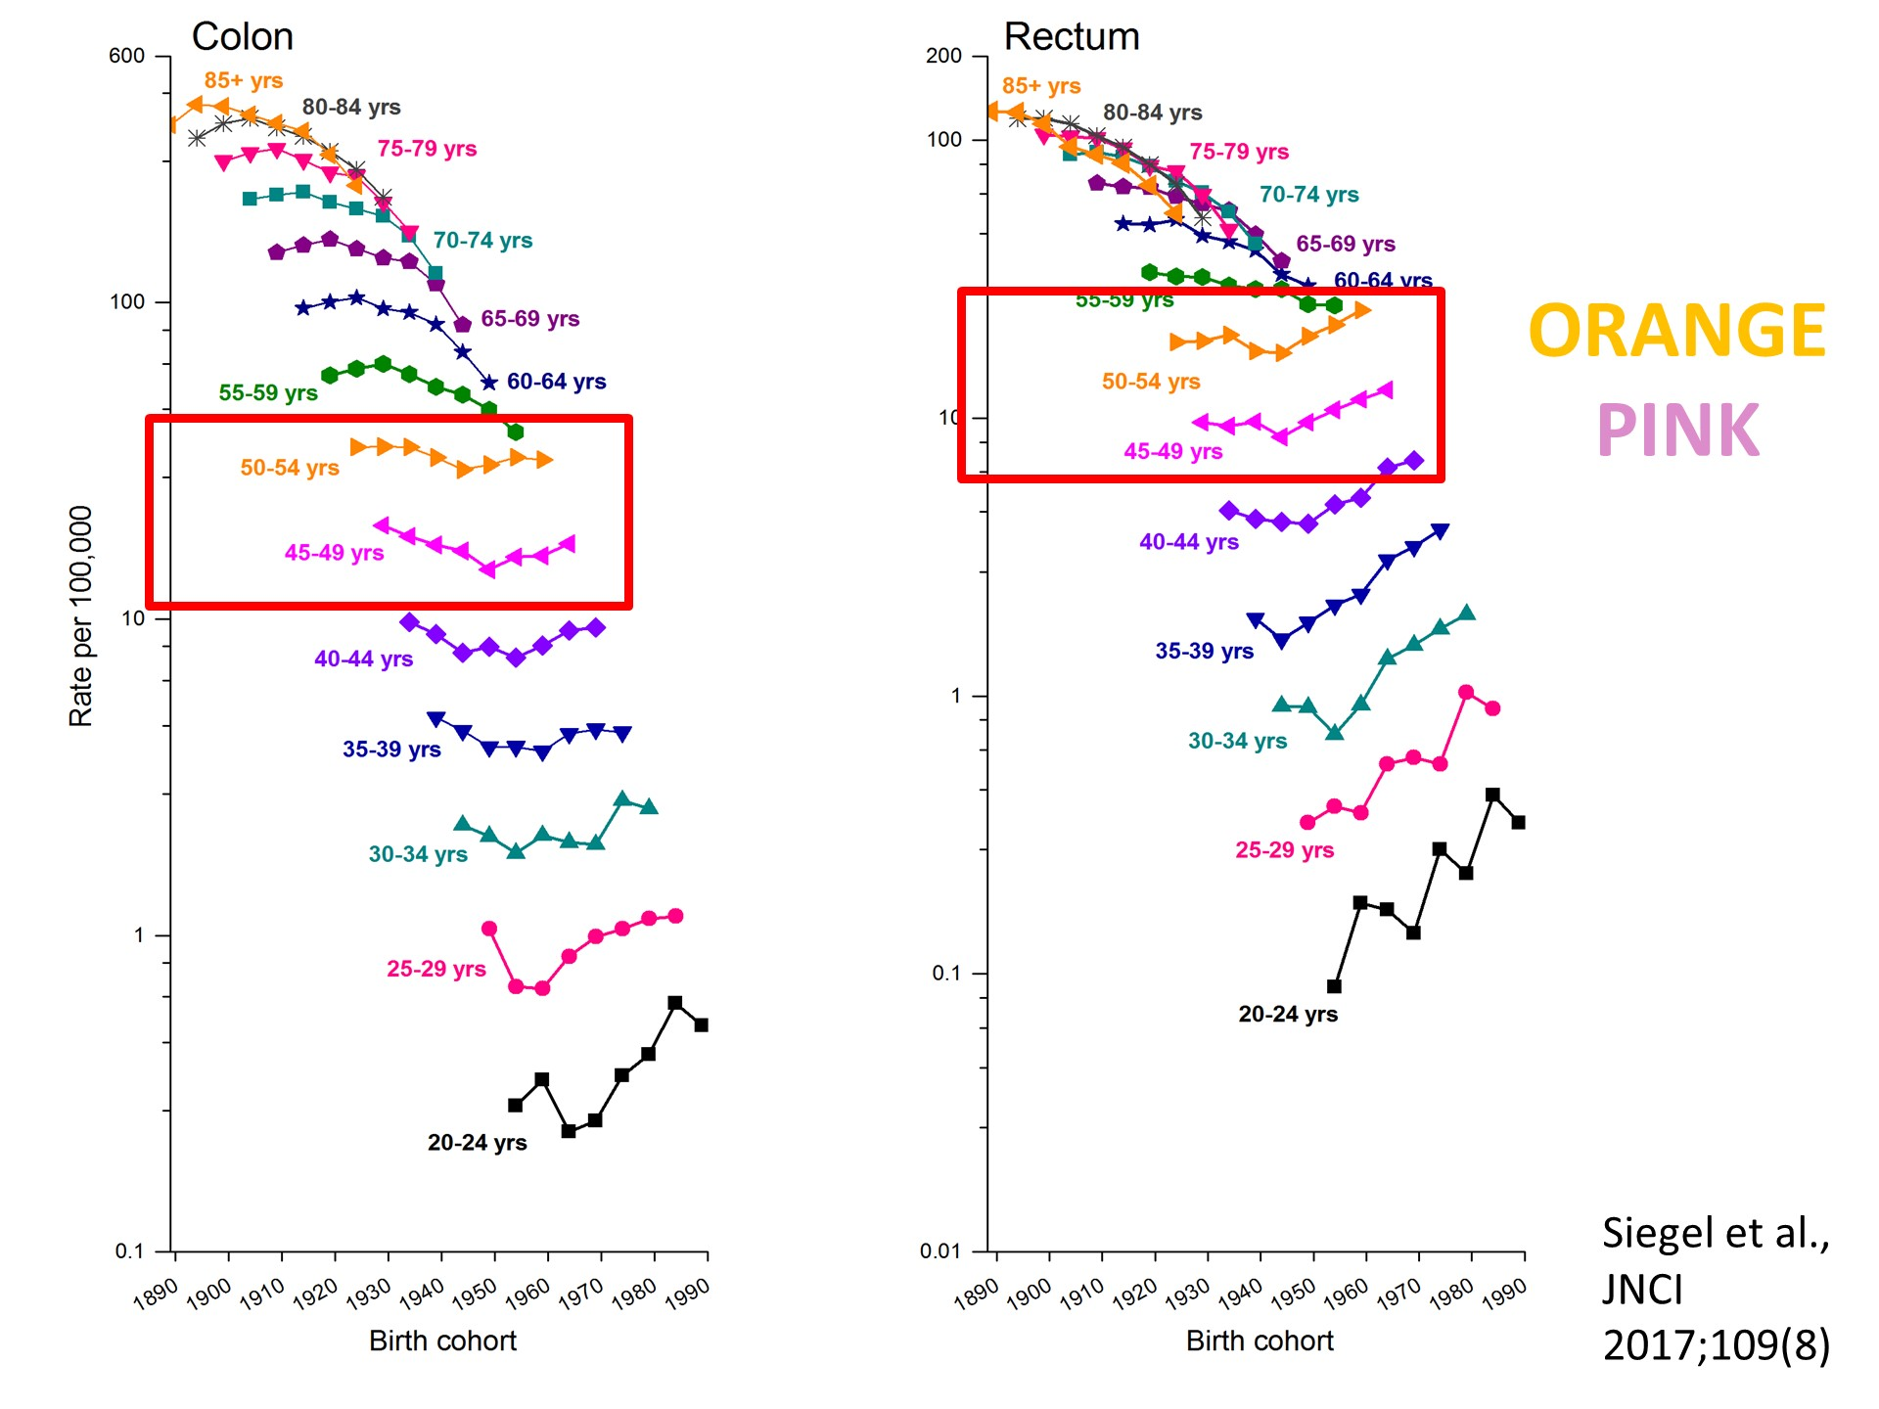
Slide 9
Presented By Uri Ladabaum at 2020 Gastrointestinal Cancer Symposium

Slide 7
Encorafenib plus Cetuximab With or Without Binimetinib for BRAF V600E–Mutant Metastatic Colorectal Cancer: <br />Quality of Life Results from a Randomized, 3-Arm, Phase 3 Study vs. the Choice of Either Irinotecan or FOLFIRI plus Cetuximab (BEACON CRC)
Presented By Scott Kopetz at 2020 Gastrointestinal Cancer Symposium

Slide 8
MAPK Pathway Inhibition in BRAF-mutant CRC
Presented By Scott Kopetz at 2020 Gastrointestinal Cancer Symposium

Slide 9
Slide 3
Presented By Scott Kopetz at 2020 Gastrointestinal Cancer Symposium

Slide 10
Baseline Patient Characteristics
Presented By Scott Kopetz at 2020 Gastrointestinal Cancer Symposium

Slide 11
Primary Overall Survival and Objective Response Rate
Presented By Scott Kopetz at 2020 Gastrointestinal Cancer Symposium

Slide 12
Maintenance of Quality of Life: EORTC QLQ-C30
Presented By Scott Kopetz at 2020 Gastrointestinal Cancer Symposium

Slide 13
BEACON CRC: Updated Analysis
Presented By Scott Kopetz at 2020 Gastrointestinal Cancer Symposium

Slide 14
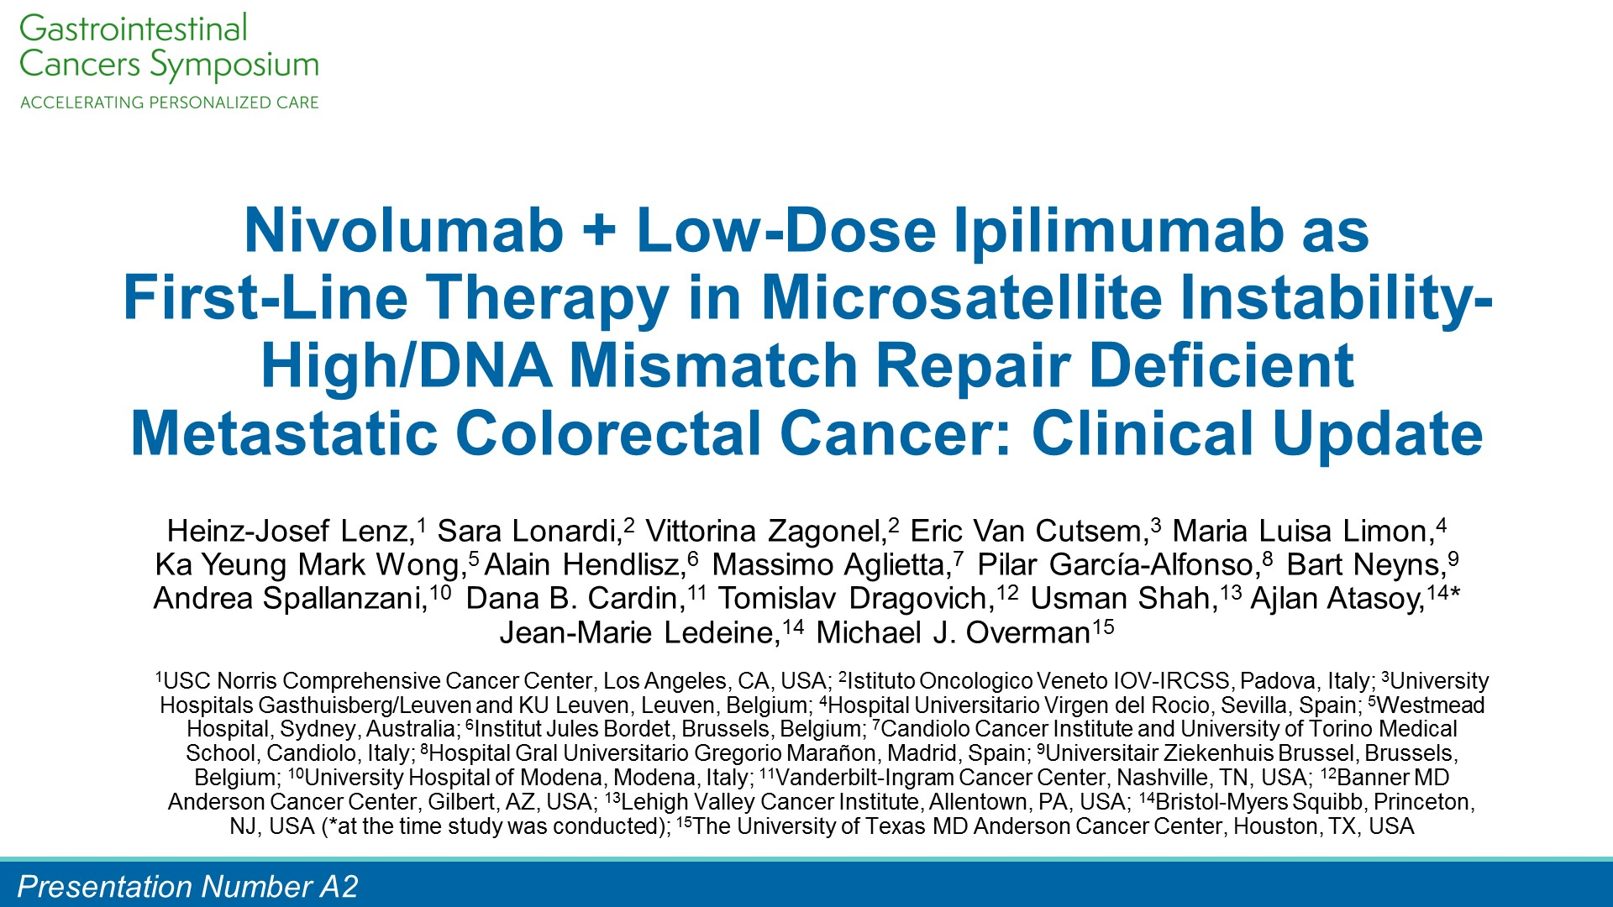
Nivolumab + Low-Dose Ipilimumab as <br />First-Line Therapy in Microsatellite Instability-High/DNA Mismatch Repair Deficient Metastatic Colorectal Cancer: Clinical Update
Presented By Heinz-Josef Lenz at 2020 Gastrointestinal Cancer Symposium

Slide 15
CheckMate 142 NIVO3 + IPI1 1L Cohort Study Design
Presented By Heinz-Josef Lenz at 2020 Gastrointestinal Cancer Symposium

Slide 16
Best Change From Baseline in Target Lesions
Presented By Heinz-Josef Lenz at 2020 Gastrointestinal Cancer Symposium

Slide 17
Progression-Free and Overall Survival
Presented By Heinz-Josef Lenz at 2020 Gastrointestinal Cancer Symposium

Slide 18
Pembrolizumab for Advanced <br />Anal Squamous Cell Carcinoma: <br />Results From the Phase 2 KEYNOTE-158 Study
Presented By Aurelien Marabelle at 2020 Gastrointestinal Cancer Symposium

Slide 19
Background
Presented By Aurelien Marabelle at 2020 Gastrointestinal Cancer Symposium

Slide 20
KEYNOTE-158 (NCT02628067)<br />ASCC Cohort
Presented By Aurelien Marabelle at 2020 Gastrointestinal Cancer Symposium

Slide 21
Best percentage change from baseline in target lesion size (RECIST v1.1, Central Review)
Presented By Aurelien Marabelle at 2020 Gastrointestinal Cancer Symposium

Slide 22
Progression-Free Survival<br />(RECIST v1.1, Central Review)
Presented By Aurelien Marabelle at 2020 Gastrointestinal Cancer Symposium

Slide 23
Summary
Presented By Aurelien Marabelle at 2020 Gastrointestinal Cancer Symposium

